Slide 1

WELCOME
WOODBRIDGE LIONS CLUB

Slide 2
INTRODUCTION TO THE INTERNATIONAL ASSOCIATION OF LIONS CLUBS

Slide 3
EMBLEM
ADOPTED 1919
2 HEADED LION
  LOOKING IN THE PAST DEPICTING PRIDE OF HERITAGE
  LOOKING FORWARD DEPICTING CONFIDENCE IN THE FUTURE

Slide 4



Pins

Slide 5
WHAT IT MEANS TO BE A MEMBER
LIONS ARE DEDICATED TO SERVING THOSE IN NEED ( IN THE LOCAL COMMUNITY OR THE WORLD)
MEMBERSHIP PROVIDES THE OPPORTUNITY TO MEET & WORK WITH INDIVIDUALS IN THE SPIRIT OF FELLOWSHIP, STRIVING TOWARDS A COMMON GOAL OF HELPING THOSE IN NEED
DEVELOP PERSONAL & PROFESSIONAL SKILLS

Slide 6
BENEFITS OF MEMBERSHIP
SATISFACTION OF HELPING THOSE IN NEED
MAKE A DIFFERENCE IN YOUR COMMUNITY
HAVING AN IMPACT ON THOSE IN NEED WORLD WIDE
DEVELOPING LEADERSHIP SKILLS
ENHANCING COMMUNICATIONS SKILLS
UTILIZING PLANNING AND ORGANIZATION SKILLS
WORKING HANDS-ON TO MEET COMMUNITY NEEDS
MEETING NEW PEOPLE FROM YOUR COMMUNITY & ABROAD
OPPORTUNITIES TO NETWORK
OPPORTUNITIES TO TRAVEL

Slide 7
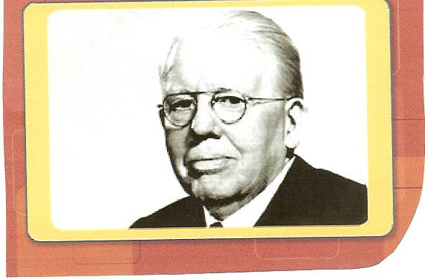
STARTED AS A DREAM
  MELVIN JONES CHICAGO INSURANCE MAN
  BELIEVED THAT LOCAL BUSINESS CLUB SHOULD EXPAND HORIZONS
  FROM BUSINESS CONCERNS
  TO THE BETTERMENT OF THEIR COMMUNITY & THE WORLD
  JONES OWN LOCAL GROUP WAS KNOWN AS THE BUSINESS CIRCLE OF CHICAGO
Melvin Jones

Slide 8
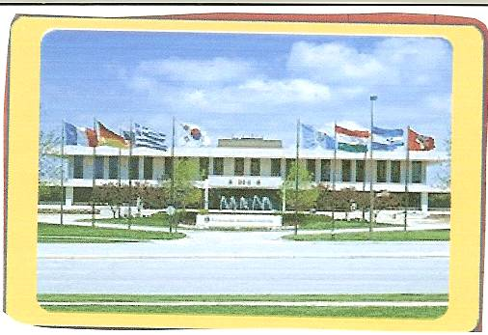
LIONS CLUB INTERNATIONAL
LOCATED IN OAK BROOK, IL
LIONS INTERNATIONAL OFFICER
OUTSIDE CHICAGO, IL

Slide 9
COLORS
PURPLE
  REPRESENTS LOYALTY TO ONE’S COUNTRY, FRIENDS & TO ONE’S SELF & TO THE INTEGRITY OF MIND & HEART. IT IS THE COLOR OF STRENGTH COURAGE & DEDICATION TO A CAUSE
GOLD
  SYMBOLIZES SINCERITY OF PURPOSE, LIBERALITY IN JUDGMENT PURITY IN LIFE AND GENEROSITY IN MIND, HEART AND PURSE TOWARDS MANKIND

Slide 10
SLOGAN
LIONS
  LIBERTY
  INTELLEGENT
  OUR
  NATIONS
  SAFETY

Slide 11
CONTACTED SIMILAR GROUPS
AN ORGANIZATIONAL MEETING
  JUNE 7, 1917
  LASALLE HOTEL IN CHICAGO
  TOOK NAME OF ONE OF THE GROUPS INVITED
  “ASSOCIATION OF LIONS CLUBS”

Slide 12
INTERNATIONAL MEMBERSHIP
1.4 MILLION MEMBERS
49,352 LIONS CLUBS
LOCATED IN 210 COUNTRIES & GEOGRAPHICAL AREAS OF THE WORLD
MOTTO
WE SERVE

Slide 13
FIRST NATIONAL CONVENTION
HELD IN OCTOBER 1917
DALLAS, TEXAS
36 DELGATES REPRESENTING 22 CLUBS FROM 9 STATES ATTENDED
CONSTITUTION, BY-LAWS, OBJECTS & CODE OF ETHICS WERE APPROVED

Slide 14
FIRST PRESIDENT
DR. W. P. WOODS FROM EVANSVILLE, IN
MELVIN JONES OUR FOUNDER AND GUIDING FORCE WAS ELECTED ACTING SECRETARY. BEGINNING HIS RELATIONSHIP WITH THE LIONS UNTIL HIS DEATH IN 1961

Slide 15
INTERNATIONAL ASSOCIATION
1920 WINDSOR, ONTARIO, CANADA
FOLLOWED BY
  MEXICO
  CHINA
  CUBA
1927 MEMBERSHIP WAS 60,000 IN 1,183 CLUBS

Slide 16
INTERNATIONAL ASSOCIATION
1935 PANAMA
1936 COLOMBIA
1947 AUSTRALIA
1948 SWEDEN & FRANCE
1952 JAPAN
1989 HUNGARY, POLAND, ESTONIA
1990 MOSCOW

Slide 17

INTERNATIONAL ASSOCIATION
CELEBRATED 100 YEARS OF SERVICE 2017

Slide 18
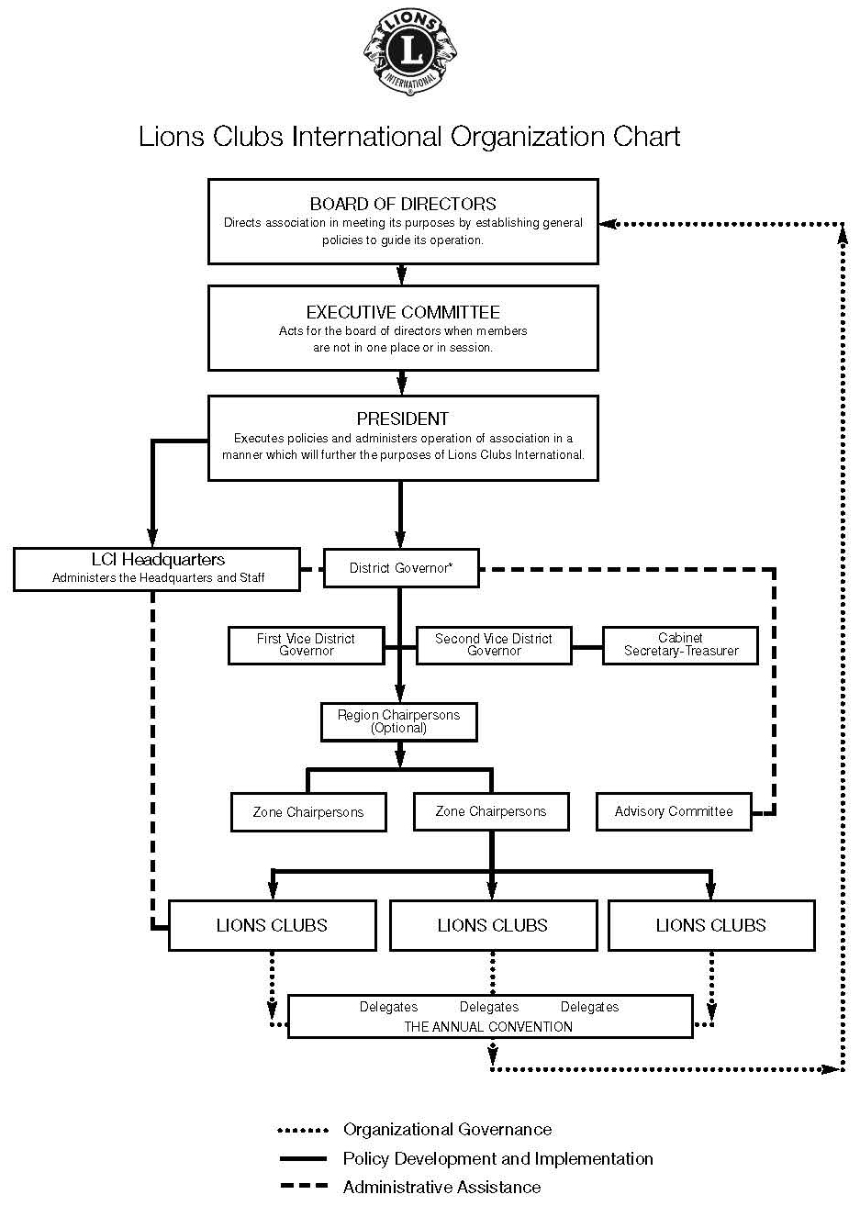

Slide 19
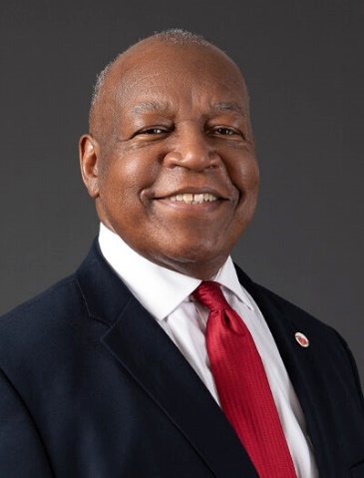

President
DOUGLAS X. ALEXANDER
HOME CLUB
Brooklyn Bedford Stuyvesant Lions Club
BROOKLYN, NY, USA

Slide 20
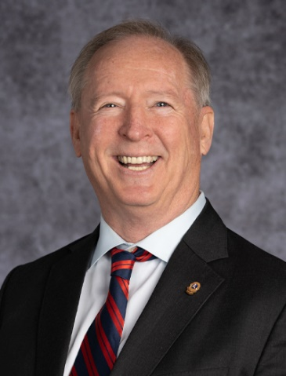
1ST Vice President
BRIAN E. SHEEHAN
HOME CLUB
BIRD ISLAND LIONS CLUB
BIRD ISLAND, MINNESOTA, USA

Slide 21
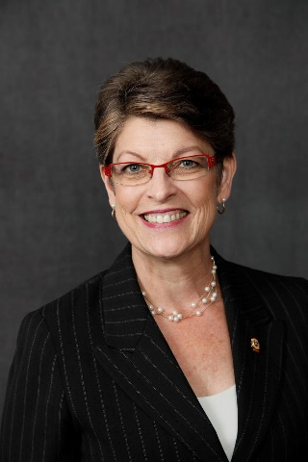
2ND Vice President
DR. PATTI HILL
HOME CLUB
EDMONTON HOST LIONS CLUB
EDMONTON, ALBERTA, CANADA

Slide 22
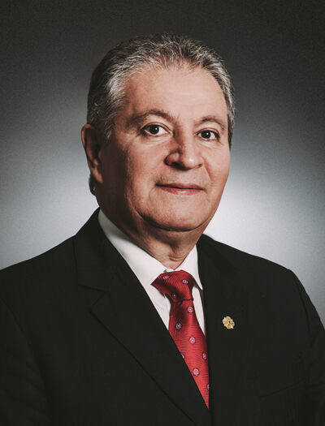
3RD Vice President
FABRÍCIO OLIVEIRA OF CATOLÉ DO ROCHA
HOME CLUB
CATOLÉ DO ROCHA LIONS CLUB
PARAIBA, BRAZIL

Slide 23
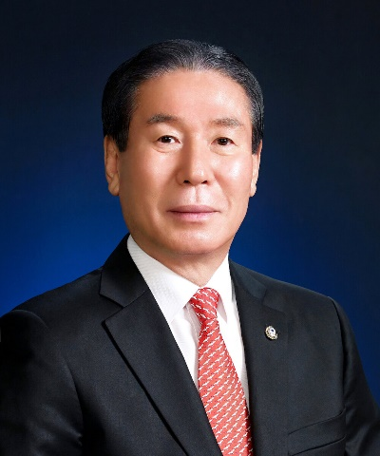
Immediate Past President
DR. JUNG-YUL CHOI
HOME CLUB
BUSAN JAE-IL LIONS CLUB
BUSAN, REPUBLIC OF KOREA

Slide 24
MOST IMPORTANT IMPACT
1925 HELEN KELLER ADDRESSED THE LIONS INTERNATIONAL CONVENTION HELD AT CEDAR POINT, OHIO
CHALLENGED LIONS TO BECOME “KNIGHTS OF THE BLIND IN THE CRUSADE AGAINST DARKNESS”

Slide 25
AGGRESSIVE SIGHT PREVENTION EFFORT
1990 LAUNCHED SIGHTFIRST
RAISED $140 MILLION
STRIVES TO RID THE WORLD OF PREVENTABLE BLINDNESS & REVERSIBLE BLINDNESS BY CLOSING THE GAP BETWEEN THE HEALTH CARE SERVICES & THOSE THAT REMAIN DESPERATELY IN NEED

Slide 26

LIONS CLUBS
INTERNATIONAL FOUNDATION (LCIF)
PROVIDES GRANT MONEY
  PROJECTS
  EMERGENCIES

Slide 27
IPP of LCI-Chairperson of LCIF
DR. JUNG-YUL CHOI
HOME CLUB
BUSAN JAE-IL LIONS CLUB
BUSAN, REPUBLIC OF KOREA

Slide 28
SIGHTFRIST II
LIONS INTERNATIONAL GOAL WAS TO RAISE $200 MILLION
  CONTINUE TO GET RID OF PREVENTABLE BLINDNESS & REVERSIBLE BLINDNESS
  RAISED ~ 250 MILLION

Slide 29
LCIF CAMPAIGN 100
LCIF CAMPAIGN 100, WHICH IS LCIF PROGRAM TO RAISE OVER $300,000,000 BY JUNE 30, 2022.
CAMPAIGN 100 WILL EMPOWER LIONS TO SERVE 200+ MILLION PEOPLE EACH YEAR

Slide 30
LCIF CAMPAIGN 100
ENSURE LIONS HAVE RESOURCES FOR OUR COMMUNITIES WITH FOCUS
VISION
YOUTH
DISASTER RELIEF
HUMANITARIAN CAUSES
HUNGER
CHILDHOOD CANCER
ENVIRONMENT

Slide 31
LIONS CLUB INTERNATIONAL(cont)
SUPPORTS SIGHT CONSERVATION
  EYE EXAMS
  EYE GLASSES
  GLAUCOMA TESTING
SUPPORTS HEARING CONSERVATION
  HEARING EXAMS
  HEARING AIDS

Slide 32
LIONS CLUB INTERNATIONAL(cont)
MEASLES
READING PROGRAMS
BOOK PROGRAMS
EYE SCREENINGS

Slide 33
OTHER MAJOR MILESTONES
1945 HELP TO FORM THE NON-GOVERNMENTAL ORGANIZATIONS SECTION AT THE UN
  HOLD CONSULTATIVE STATUS TODAY
1987 FIRST MAJOR SERVICE CLUB TO ADMIT WOMEN

Slide 34
Other Sight Items
Improved Eye Care for 100 Million people by training more than 650k eye professionals
Vaccinated 41 Million children in Africa for measles

Slide 35

MD 24
STATE OF VIRGINIA
  3 SUB-DISTRICTS
    24-L (89 CLUBS; 2,421 MEMBERS)(APRIL 7, 2022)
    24-C (59 CLUBS; 1,335 MEMBERS)(APRIL 7, 2022)
    24- I (88 CLUBS; 2,092? MEMBERS)(APRIL 7, 2022)
  TOTAL CLUBS 236 WITH 5,848 MEMBERS
  COUNCIL OF GOVERNORS
  SECRETARY/TREASURER LION TAMMIE BRIGHTWELL
501 ELM AVE . SW ROANOKE, VA 24016

Slide 36
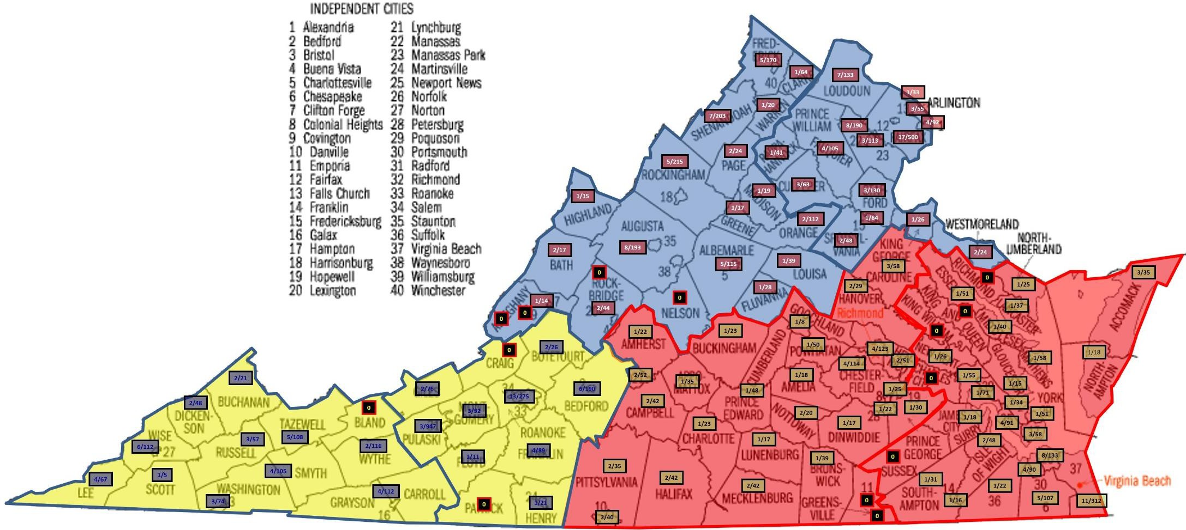
MD 24 SUB-DISTRICT MAP
SUB-DISTRICT “L”
SUB-DISTRICT “C”
SUB-DISTRICT “I”

Slide 37
COUNCIL CHAIR
DONNA WEILER
HOME CLUB
TAPPAHANNOCH LIONS CLUB

Slide 38
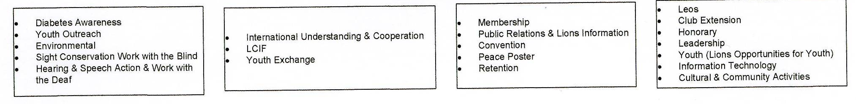
Multiple District 24 Organization
Council Chair
DONNA WEILER
Vice Council Chair
Eric Mills
MD Secretary/Treasurer
Tammie Brightwell
IPCC
Wilma Murphy
Committees
District 24-L
Governor
District 24-C
Governor
District 24-E
Governor
Regions
Regions
Regions
Zones
Zones
Zones

Slide 39
24-L COMMITTEES (cont.)
BLAND MUSIC SCHOLARSHIP FOUNDATION, INC
BLAND MUSIC SCHOLARSHIP CONTEST
BUDGET
CHAPLAIN
CHILDHOOD CANCER
CONSTITUTION & BYLAWS
DIABETES AWARENESS
DISASTER RESPONSE/ ENVIRONMENTAL
DISTRICT LIONS CHARITY, INC
ETHICS
FALL CONFERENCE/DISTRICT CONVENTION
FOUNDATION FIGHTING BLINDNESS
GLOBAL ACTION TEAM
GLOBAL LEADERSHIP TEAM
GLOBAL MEMBERSHIP APPROACH
GLOBAL MEMBERSHIP TEAM
GLOBAL MEMBERSHIP TEAM RETENTION – NEW MEMBER ORIENTATION
GLOBAL SERVICE TEAM
HEARING AID BANK FOUNDATION
HEARING CONSERVATION
INFORMATION TECHNOLOGY
INTERNATIONAL CONVENTION
INTERNATIONAL LIAISON
INTERNATIONAL RELATIONS
LEADER DOGS FOR THE BLIND

Slide 40
24-L COMMITTEES (cont.)
LEO CLUBS/CAMPUS CLUBS
LIONS CLUBS INTERNATIONAL FOUNDATION
LIONS EYEGLASS RECYCLING CENTER OF NORTHERN VIRGINIA, INC.
NORTHERN VIRGINIA LIONS MOBILE SIGHT AND HEARING SCREENING UNIT
NORTHERN VIRGINIA LIONS YUTH CAMP
PEACE POSTER CONTEST
PIN TRADERS CLUB OF VIRGINIA
PROTOCOL
PUBLIC RELATIONS
READING ACTION PROGRAM
RELIEVING HUNGER
SERGEANT AT ARMS
SIGHT & HEARING MOBILE SCREENING UNIT
SIGHT CONSERVATION
SOCIAL MEDIA
SPECIAL NEEDS EQUIPMENT
STAMPS FOR THE WOUNDED
STATE CONVENTION
USA/CANADA LIONS LEADERSHIP FORUM
VIRGINIA LIONS EYEGLASS RECYCLING, INC.
VIRGINIA LIONS HEARING AID BANK FOUNDATION
VISITATION
WHITE CANE
WOMEN & FAMILY MEMBERSHIP DEVELOPMENT
WORLDWIDE INDUCTION DAY
YOUTH EXCHANGE/OUTREACH

Slide 41
LIONS DISTRICT 24-L

Slide 42
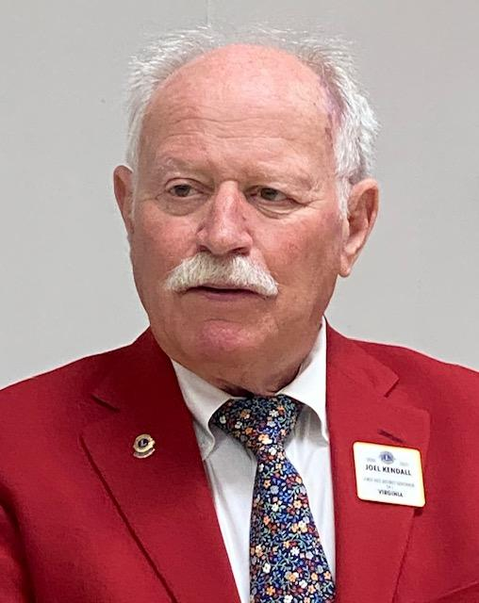
DISTRICT GOVERNOR
JOEL KENDALL
HOME LIONS CLUB
LOUISA LIONS CLUB

Slide 43
District 24-L Organization
District Governor
Joel Kendall
1st Vice District Governor
Rose Burrus
Secretary
Wilma Murphy
2nd Vice District Governor
Donalda Lovelace
Treasurer
Mark Armendaris
Northeast
Southeast
Blue Ridge
Shenandoah Valley
6 Zones
4 Zones
4 Zones
3 Zones
Zone # D
Clubs
Dale City
Montclair
Prince William Roaring
Virginia Gateway
Woodbridge
Montclair Leos

Slide 44
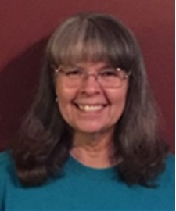
1ST VICE DISTRICT GOVERNOR
ROSE BURRUS
HOME LIONS CLUB
STAFFORD COUNTY LIONS CLUB

Slide 45
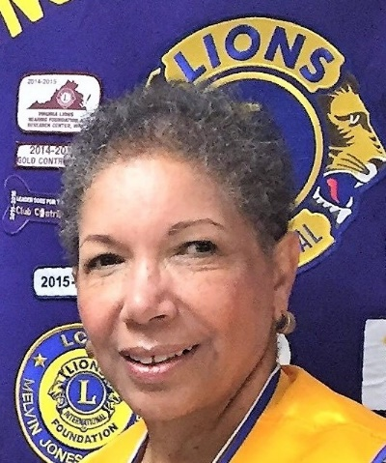
2ND VICE DISTRICT GOVERNOR
DONALDA LOVELACE
HOME LIONS CLUB
LAKE OF THE WOODS LIONESS CLUB

Slide 46
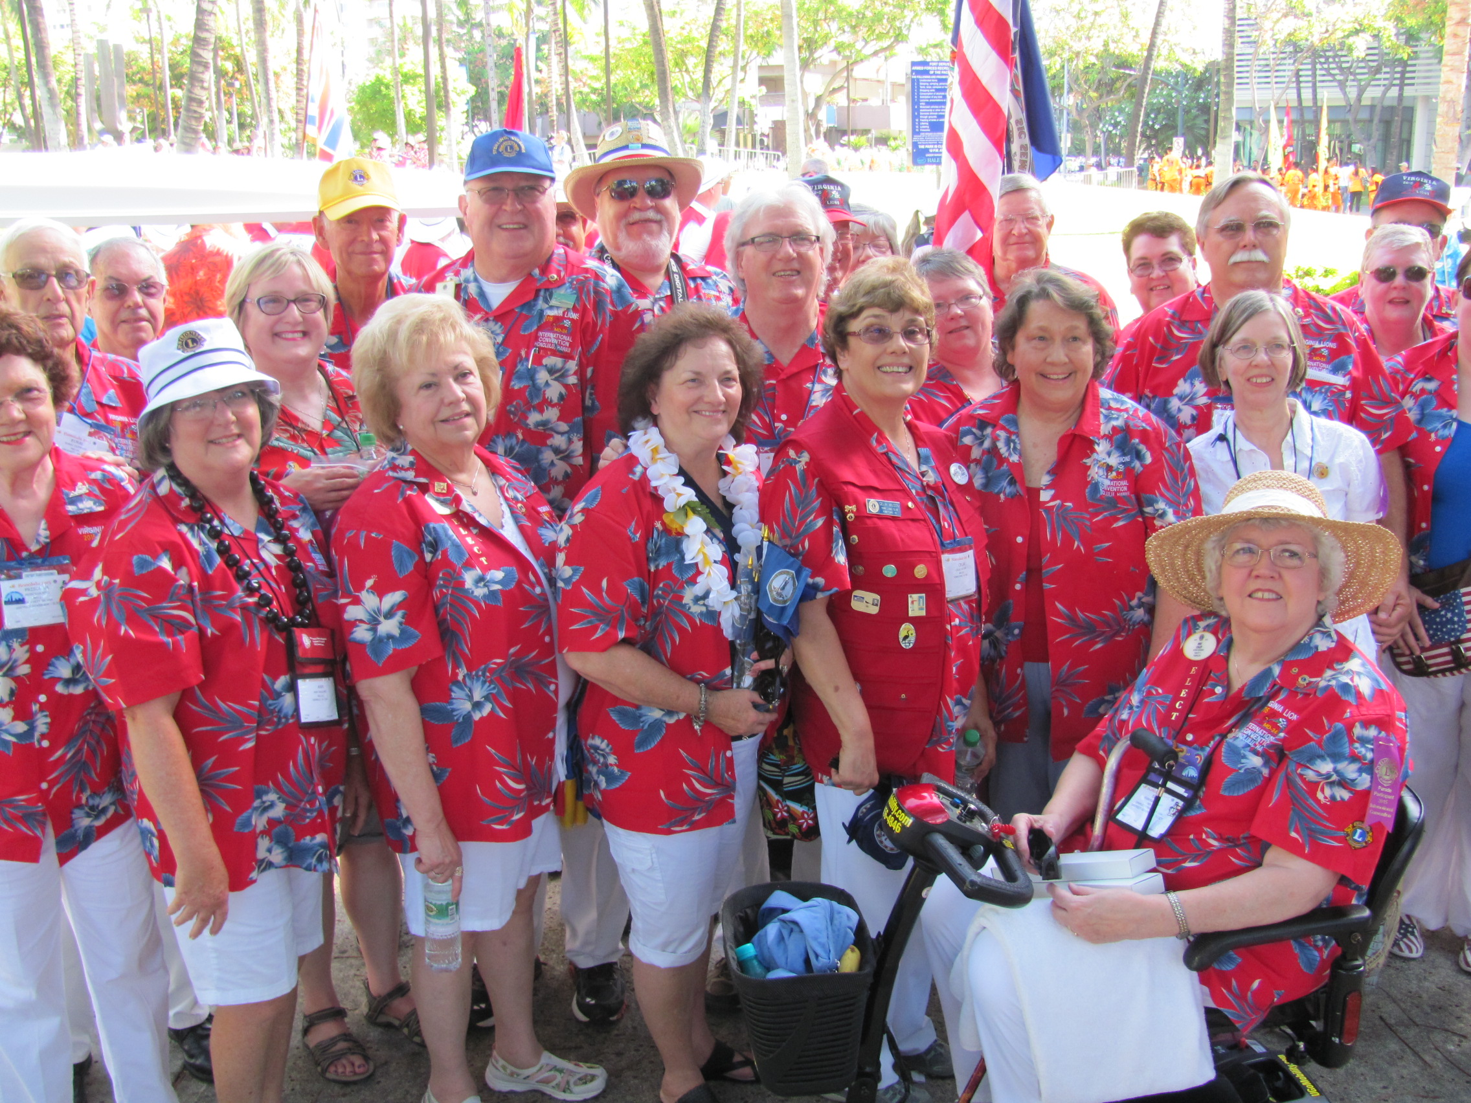
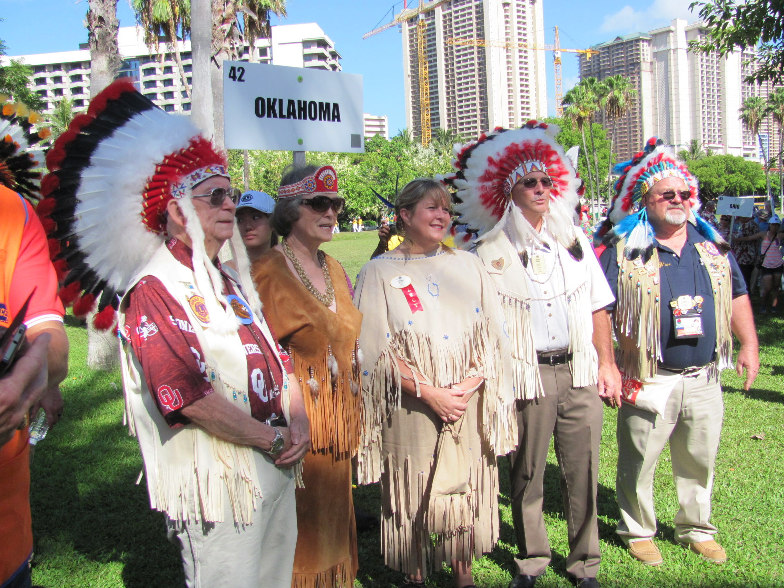
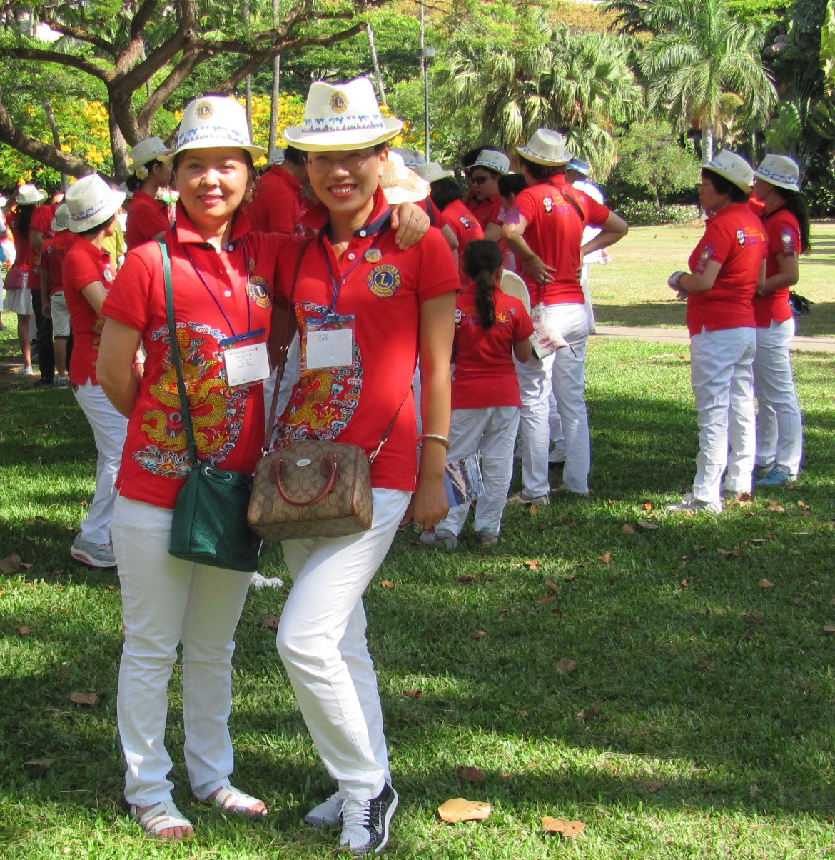
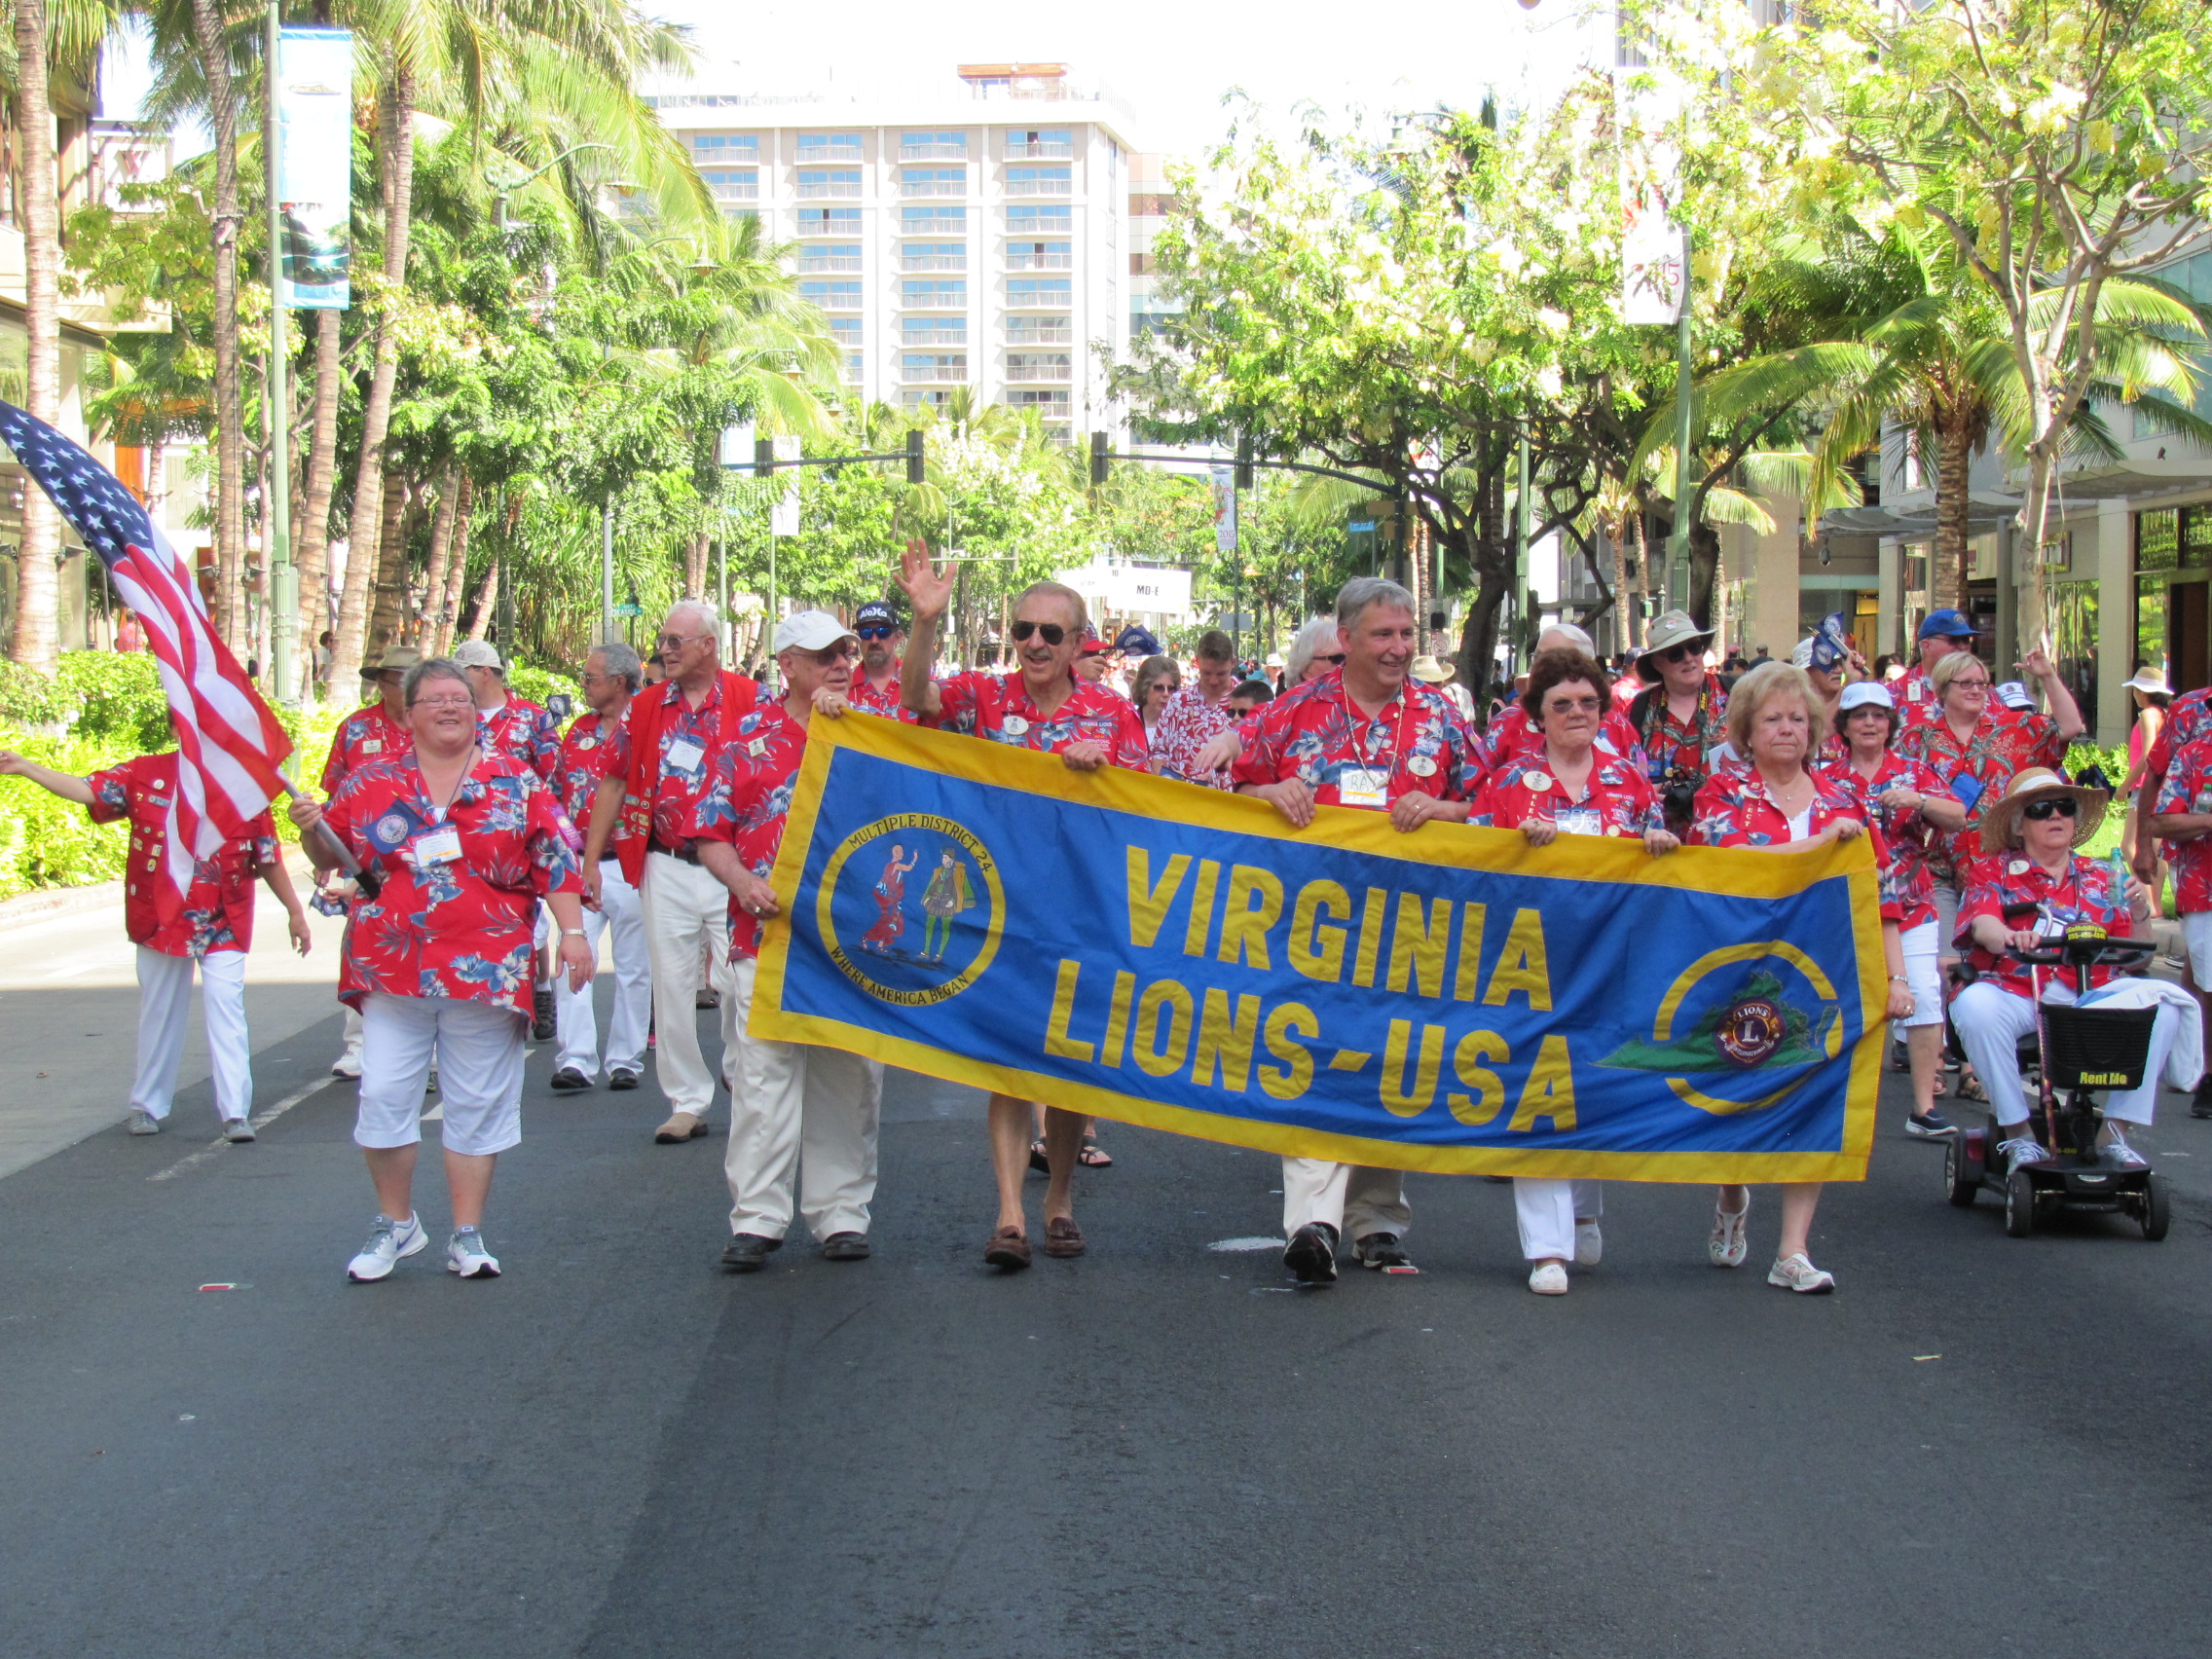
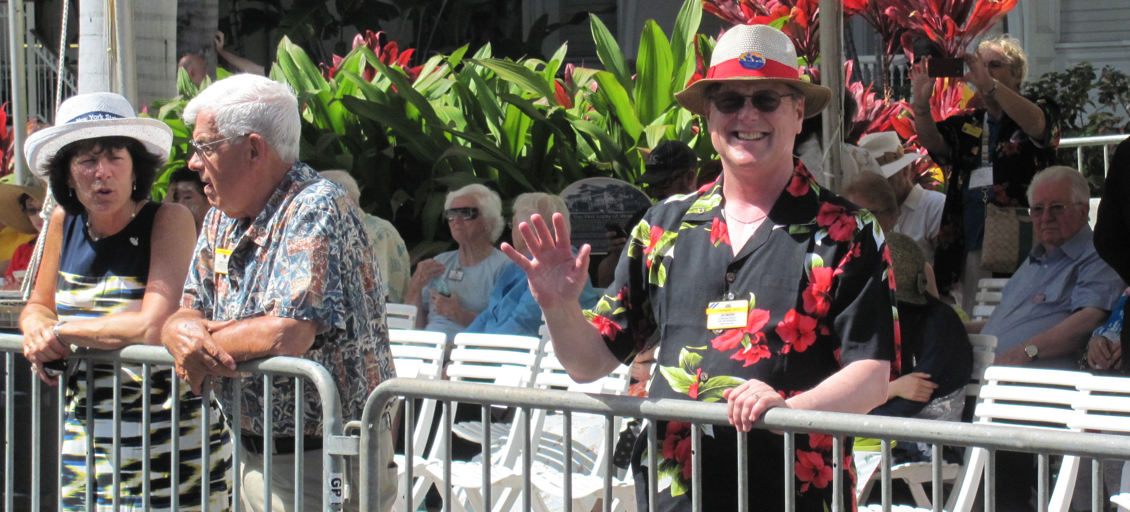
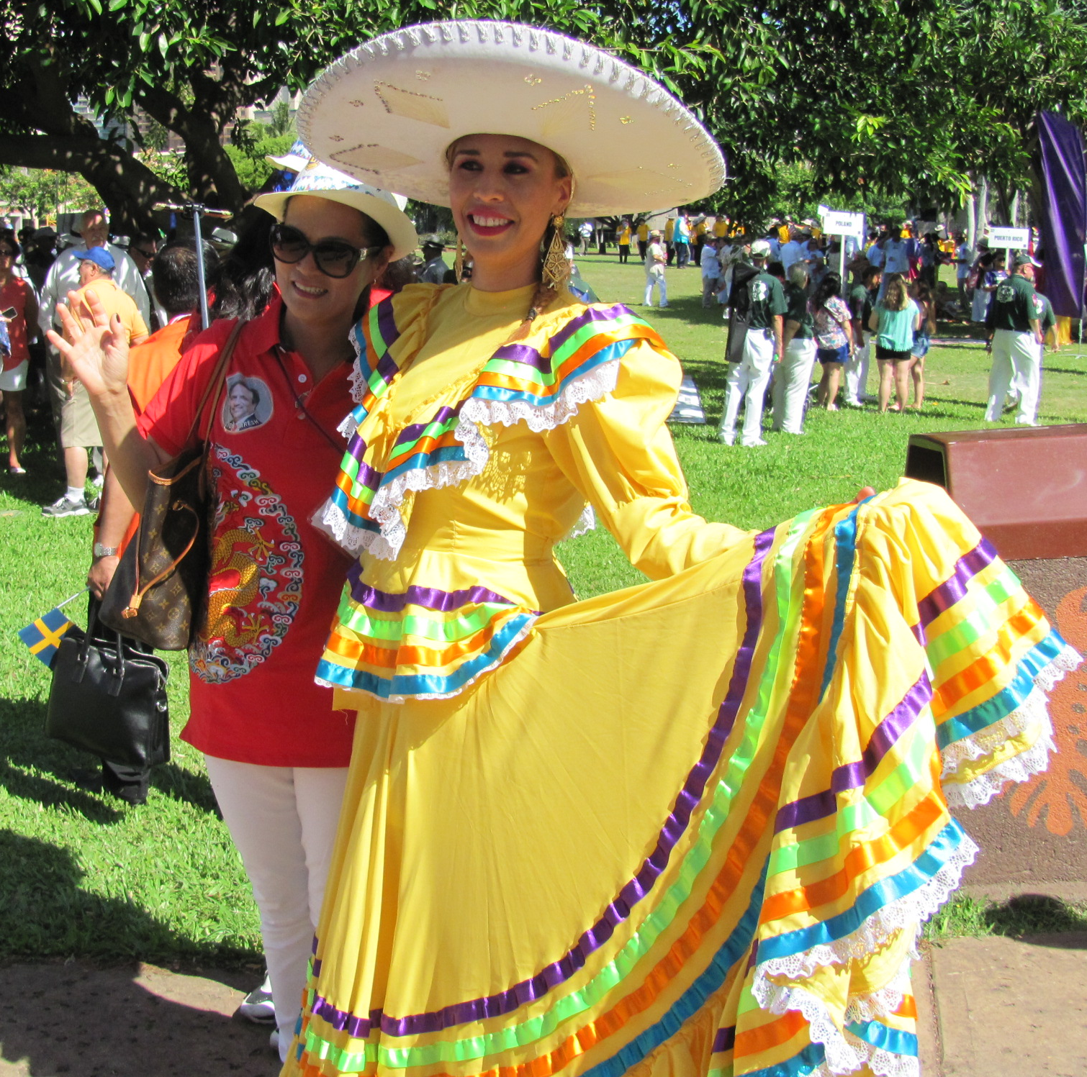
THE
INTERNATIONAL PARADES

Slide 47
ANYTOWN LIONS CLUB
PRESIDENT
1ST VICE PRESIDENT
2nd VICE PRESIDENT
SECRETARY
TREASURER
LION TAMER
TAIL TWISTER
DIRECTORS
MEMBERSHIP DIRECTOR

Slide 48
ANYTOWN LIONS CLUB
WILL DECIDE WHAT FUND RAISERS & ACTIVITIES YOU WANT TO HOLD AND/OR SUPPORT

Slide 49
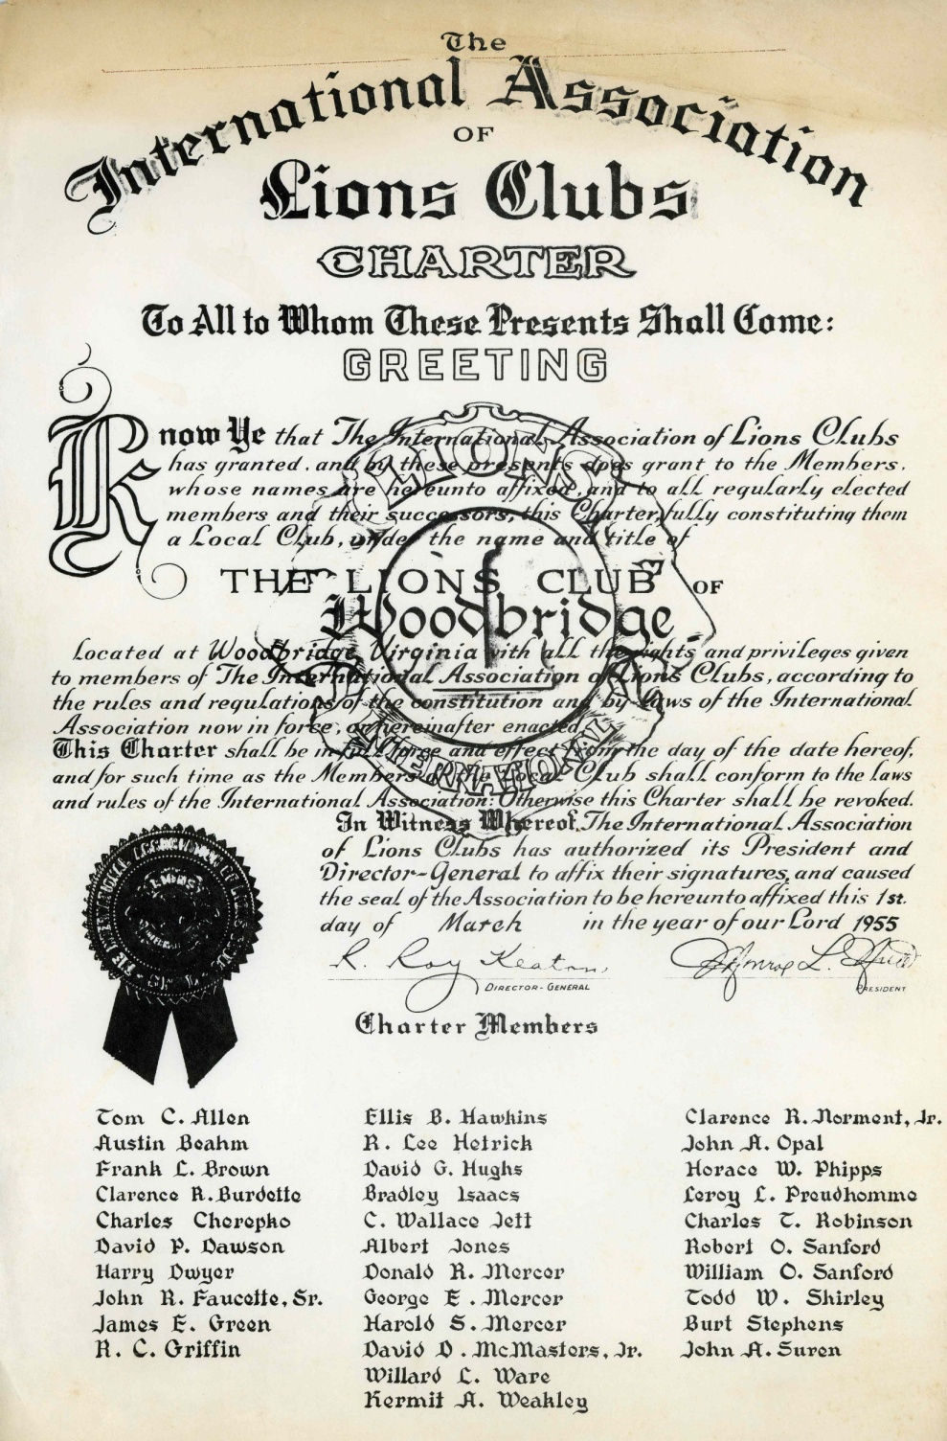

Slide 50
Woodbridge Lions Club History
1st BOD Meeting Held @ Occoquan School
Chartered March 1, 1955
32 Members
Dinner Meeting Stan’s, Lorton, VA
1st Charter Night held @ Princess Anne Hotel Fredericksburg 4/23/55
Sponsoring Lions Club: Quantico

Slide 51
ADMINISTRATIVE COMMITTEES
ALUMINUM CAN COLLECTIONS
DINNER MEETINGS COORDINATOR
FIFTY-FIFTY RAFFLE
FOUR SEASONS CLUB LIAISON
GOODWILL AMBASSADOR
MEMBERSHIP
NOMINATION OF OFFICERS
OFFSITE RETREATS
SONG MASTER
SPEAKER’S PROGRAMS
VISITATIONS

Slide 52
CHARITIES COMMITTEES (CONT)
ACTS FOOD BANK COLLECTION
ACTS HOMELESS CHILDREN’S SHELTER
ADOPT-A-SPOT
COAT DRIVE
DINNER FUNDRAISER(S)
EYEGLASS RECYCLING
FOSTER TEEN PROGRAM AT CHRISTMAS
GOLF TOURNAMENT
LITERACY PROGRAM (RIP/RAP)
NORTHERN VA LIONS YOUTH CAMP
OTHER FUNDRAISERS – TBD
ACTS FOOD BANK COLLECTION
ACTS HOMELESS CHILDREN’S SHELTER
ADOPT-A-SPOT
COAT DRIVE
DINNER FUNDRAISER(S)
EYEGLASS RECYCLING
FOSTER TEEN PROGRAM AT CHRISTMAS
GOLF TOURNAMENT
LITERACY PROGRAM (RIP/RAP)
NORTHERN VA LIONS YOUTH CAMP
OTHER FUNDRAISERS - TBD
SAM WOODS AWARD & HONORING DECEASED MEMBERS
SEAFOOD SALE FUNDRAISERS
SGT MAC FOUNDATION
SIGHT EXAMS, EYEGLASSES & HEARING AIDS
VISION
VISION SCREENING
WHITE HOUSE ORNAMENTS
WOW PROGRAM
YOUTH SERVICE PROGRAMS

Slide 53
CHARITIES COMMITTEES (CONT)
SAM WOODS AWARD
  HONORING DECEASED MEMBERS
SEAFOOD SALE FUNDRAISERS
SGT MAC FOUNDATION
SIGHT EXAMS
EYEGLASSES
HEARING AIDS
VISION
VISION SCREENING
WHITE HOUSE ORNAMENTS
WOW PROGRAM
YOUTH SERVICE PROGRAMS
ACTS FOOD BANK COLLECTION
ACTS HOMELESS CHILDREN’S SHELTER
ADOPT-A-SPOT
COAT DRIVE
DINNER FUNDRAISER(S)
EYEGLASS RECYCLING
FOSTER TEEN PROGRAM AT CHRISTMAS
GOLF TOURNAMENT
LITERACY PROGRAM (RIP/RAP)
NORTHERN VA LIONS YOUTH CAMP
OTHER FUNDRAISERS - TBD
SAM WOODS AWARD & HONORING DECEASED MEMBERS
SEAFOOD SALE FUNDRAISERS
SGT MAC FOUNDATION
SIGHT EXAMS, EYEGLASSES & HEARING AIDS
VISION
VISION SCREENING
WHITE HOUSE ORNAMENTS
WOW PROGRAM
YOUTH SERVICE PROGRAMS

Slide 54
COMMITTES
(ADM & CHARITIES)
BUDGET
FACEBOOK
FUNDRAISERS (specifically identified)
PAWPRINTS & MEDIA
PUBLIC RELATIONS
WEBSITE

Slide 55
Woodbridge Lions Sponsored
Lake Ridge Lions Club 7/1974
Dale City Lions Club 2/1969
Woodbridge Lioness Auxiliary 11/1957
Woodbridge Lioness 11/1976
Woodbridge Sunset Lions Club 5/1999
Woodbridge Leo Club 1976-1977

Slide 56
Woodbridge Fund Raising Events
Light Bulbs, Halloween Candy, Christmas Trees, Bingo, Truck Raffle, Shrimp Sales, Golf Tournament, Whitehouse Christmas Ornaments & Dinners
In excess of $1,000,000.
Supported and donated many dollars to the Potomac (Sentra) Hospital.

Slide 57
Supported Programs
Supported "Turn in a Pusher" and has supported many Youth Activities, Scholarships, purchased Eye and Hearing Exams, Glasses, Learns, Youth Screenings, Hearing aids, Environmental .
Planted trees

Slide 58
Woodbridge Lions Club
Twelfth Lions Club Chartered in Northern Virginia and was than in District 24-C Zone 1 with the Annandale, Arlington Host, Arlington Northwest, Arlington South, Bailey's Cross Roads, Edgewater, Falls Church, Mt. Vernon, Quantico, Springfield-Alexandria.

Slide 59
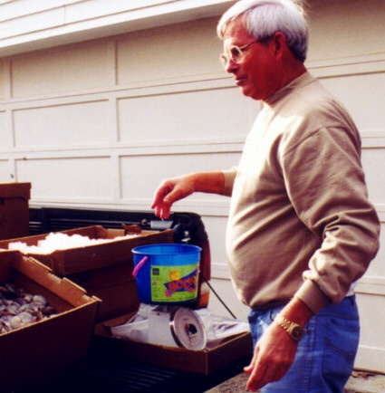
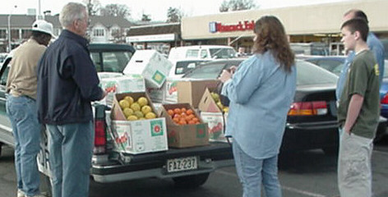
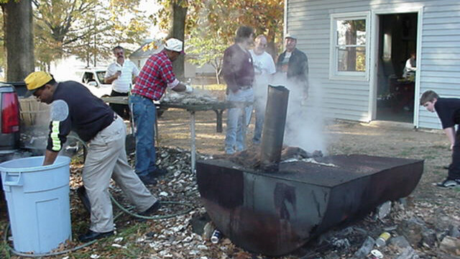
FUND RAISINGS
FRUIT SALES
SHRIMP SALES
OYSTER ROAST

Slide 60
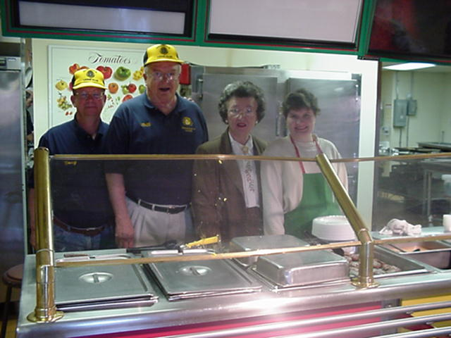
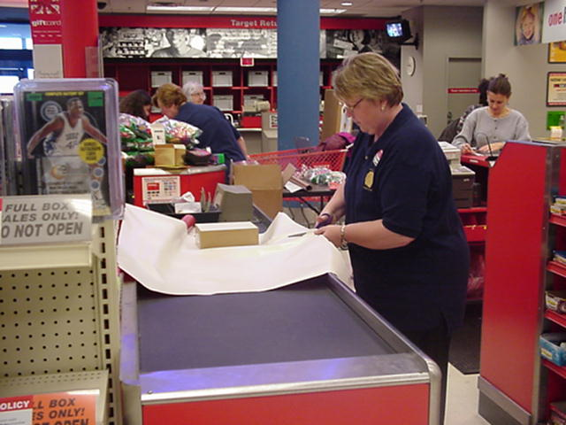
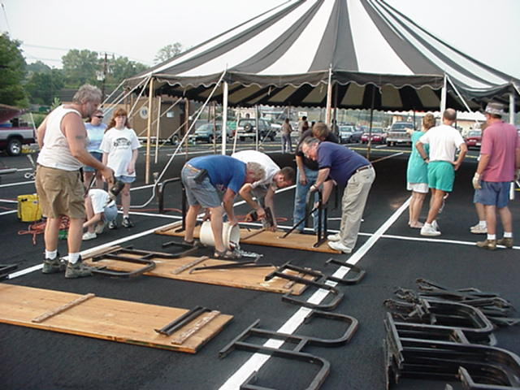
FUND RAISINGS
SERVING DINNERS
GIFT WRAPPING
BINGO?

Slide 61
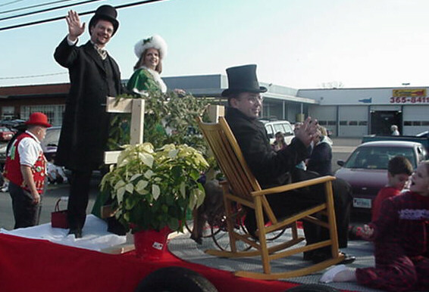
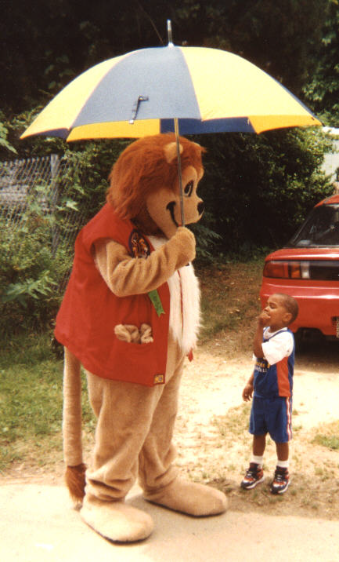
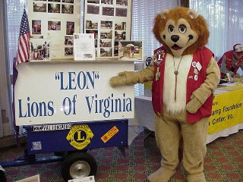
FUN
PARADES
PUBLIC RELATIONS
PUBLIC RELATIONS

Slide 62
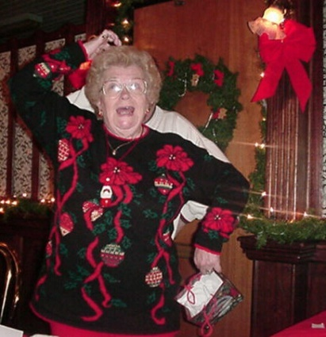
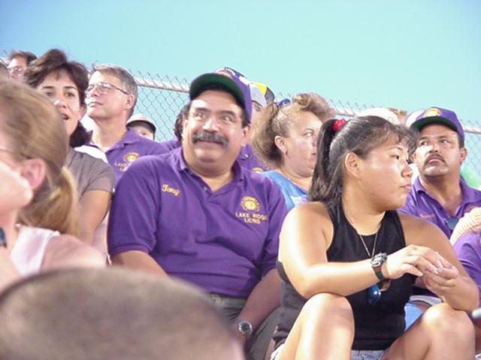
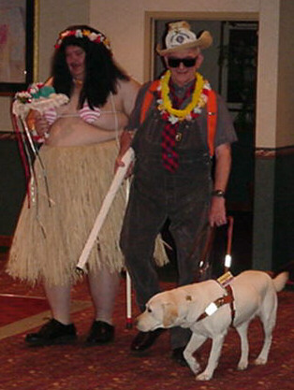
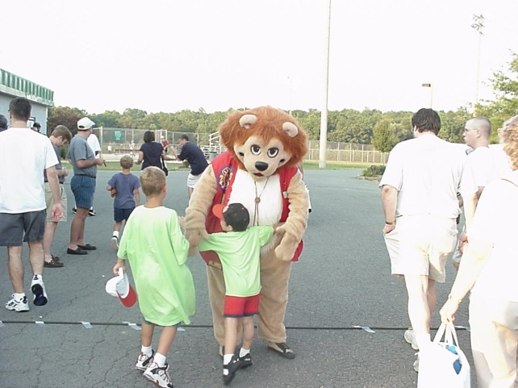
FUN
GOOD TIMES
BASEBALL GAME
SHOTGUN WEDDING
WELCOME

Slide 63
WEB SITES
VALIONS.ORG (DISTRICT 24-L)
LIONSOFVIRGINIA.ORG (STATE)
LIONSCLUBS.ORG (INTERNATIONAL)

Slide 64
SERVICE PROJECTS

Slide 65
DIABETES AWARENESS
EDUCATE THE PUBLIC
  DIABETES
  EFFECTS ON SIGHT
  MACULA DEGENERATION
  BLOOD SUGAR

Slide 66
EYEGLASS RECYCLING CENTER NORTHERN VA
ARLINGTON
COLLECTS USED EYE GLASSES
CLEANS
CATALOGS
PACKAGE
PROVIDES GLASSES FOR MISSON TRIPS

Slide 67
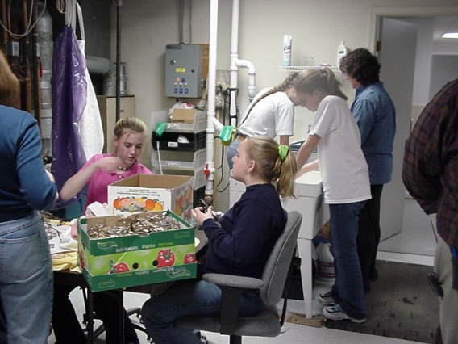
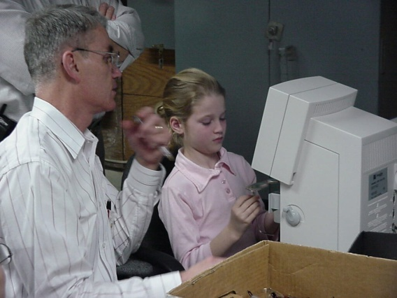
EYEGLASS RECYCLING CENTER NORTHERN VA (CONT)
GIRL SCOUTS
CLEANING GLASSES
GIRL SCOUT & LION
CATALOGING GLASSES

Slide 68
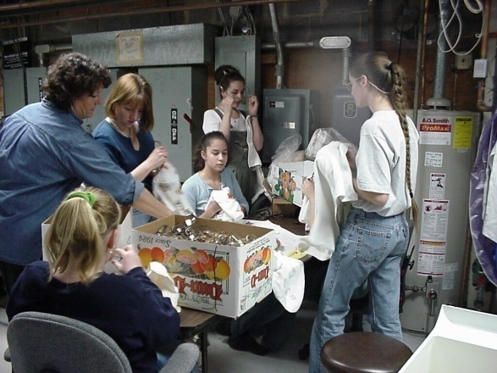
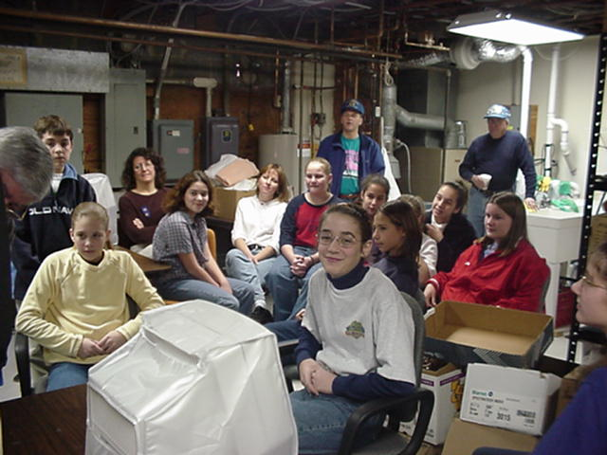
EYEGLASS RECYCLING CENTER NORTHERN VA (CONT)
GIRL SCOUTS DRYING GLASSES
GIRL SCOUTS & LIONS
COMPLETED THE JOB

Slide 69
HABITAT FOR HUMANITY
PARTNERSHIP WITH HABITAT OF HUMANITY NORTHERN VIRGINIA
RECEIVED LCIF GRANT
PROVIDED LABOR TO BUILD HOUSE
FAMILY MOVED INTO HOUSE

Slide 70
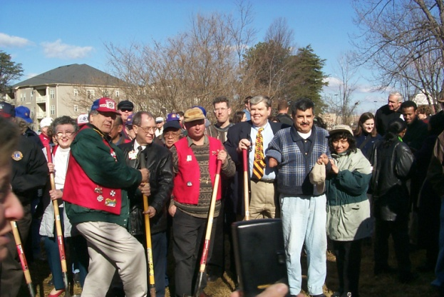
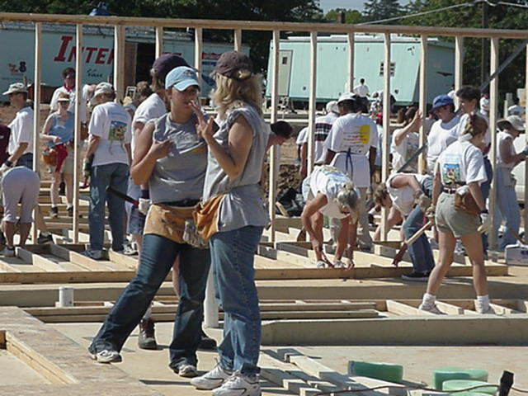
HABITAT FOR HUMANITY (cont.)
GROUNDING BREAKING
1ST WALL

Slide 71
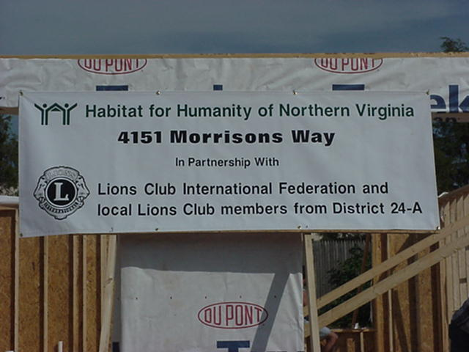
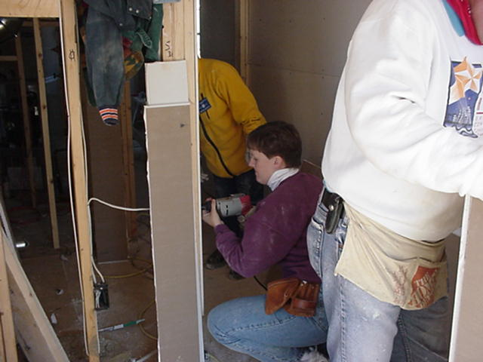
HABITAT FOR HUMANITY (cont.)
LIONS HOUSE
LIONS INSTALLING DRY WALL

Slide 72
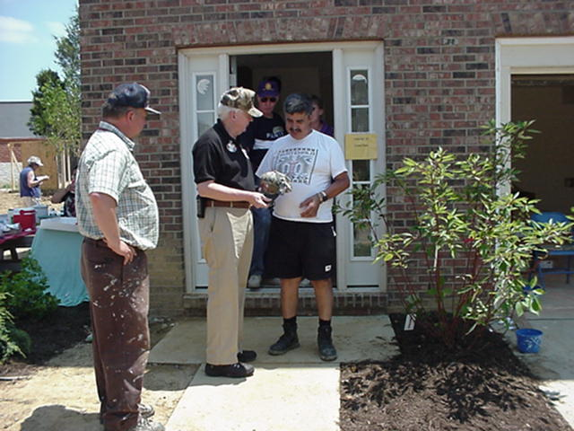
HABITAT FOR HUMANITY (cont.)
COMPLETED HOUSE

Slide 73

HEARING AID BANK FOUNDATION
COLLECT USED HEARING AIDS
RECYCLE HEARING AIDS
PROVIDE FUNDING FOR HEARING EXAMS
PROVIDE FUNDING FOR HEARING AIDS

Slide 74
HEARING CONSERVATION
EDUCATE THE PUBLIC
  NOISE LEVELS
  EFFECTS ON HEARING
  HEARING LOSS
  PREVENTIVE MEASURERS

Slide 75
VA LIONS HEARING FOUNDATION & RESEARCH CENTER
To initiate and support hearing research on deafness and hearing problems in all age groups.
a) Basic Science Research: Ototoxicity (drug damage); Noise Damage; Electrical Stimulation of Auditory Nerves; Regeneration of Hair Cells
b) Clinical Research: Study of temporal bone anatomy and testing of new surgical procedures and/or new implantable devices concerned with ear diseases and hearing disorders.

Slide 76
VA LIONS HEARING FOUNDATION (CONT)
To support the Cochlear Implant Program, for the rehabilitation of profound deafness in children and adults.
• To conduct diagnostic clinical examinations, which may result in surgery (e.g.. cochlear implant) or other rehabilitative procedures (e.g.. hearing aids) to restore partial or complete hearing to individuals.
• To conduct informational programs to educate the public on hearing disorders and to encourage hearing protection.
• To initiate educational programs for practicing ear surgeons on the latest surgical techniques to better care for the hearing impaired individuals throughout Virginia and beyond.

Slide 77
VA LIONS HEARING FOUNDATION (CONT)
Organized in 1978
Lions of Virginia have contributed over $1,200,000 to the Foundation in support of their objectives
Donations from the general public or corporations are gratefully accepted.

Slide 78

INTERNATIONAL RELATIONS
CLUB TWINNING
LIONS AT THE UNITED NATIONS
WORLD PEACE DAYS
USA/CANADA LEADERSHIP FORUM

Slide 79

LEADER DOGS FOR THE BLIND
FOUNDED BY MICHIGAN LIONS IN 1939
LOCATED IN ROCHESTER, MI
TRAIN GUIDE DOGS FOR THE BLIND
OVER 10,000 BLIND PEOPLE HAVE BECOME SELF-SUFFICIENT
NO COST TO THE BLIND PERSON
COST $40,000 PER TEAM (DOG & PERSON)

Slide 80
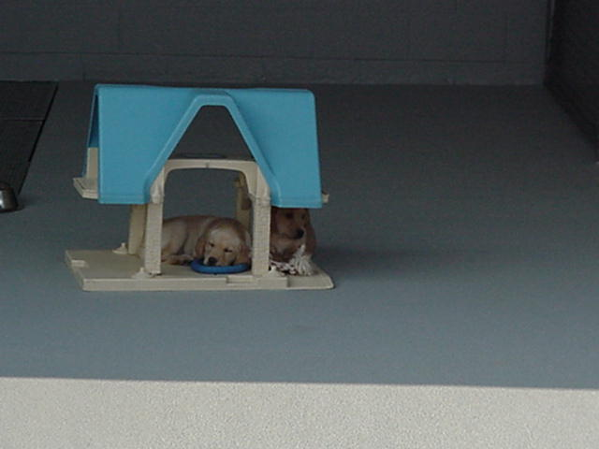
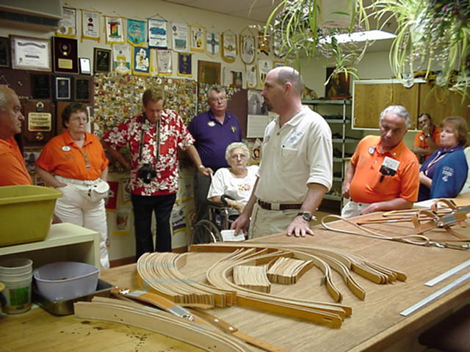
LEADER DOGS(cont)
IN TRAINING
HARNESS SHOP

Slide 81
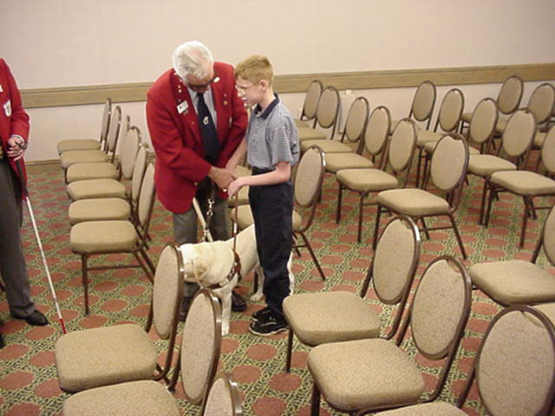
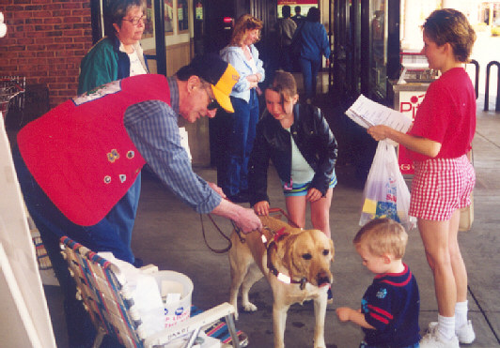
LEADER DOGS(cont)
TEACHING FRIENDS ABOUT LEADER DOG

Slide 82
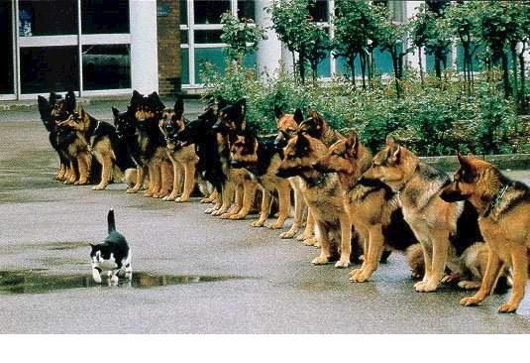
AM I IN TROUBLE?

Slide 83
LIONS CLUBS
INTERNATIONAL FOUNDATION (LCIF)
PROVIDES GRANT MONEY
  PROJECTS
  EMERGENCIES

Slide 84
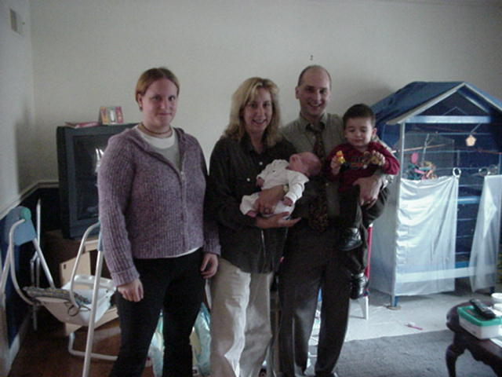
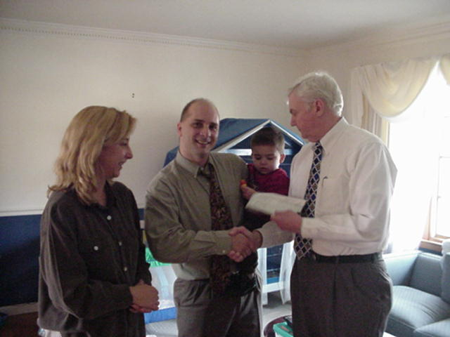
LCIF (cont.)
SUPPORT FOR
911 SECONDARY
VICTIMS
PDG GIVING LCIF RELIEF FUNDS

Slide 85


LIONS OF VIRGINIA FOUNDATION
(LOVF)

Slide 86
LOVF
STATE HUMANITIAN FOUNDATION
PROVIDES ASSISTANCE
NATURAL DISASTER
  FLOODS
  HURRICANE
FUNDS LIONS PROJECTS

Slide 87

OLD DOMINION EYE FOUNDATION
GIVE THE GIFT OF SIGHT
NON-PROFIT MEDICAL FACILITY THAT PROVIDES HUMAN EYE TISSUE FOR CORNEAL TRANSPLANTS, OPHTHALMIC RESEARCH & EDUCATION TRAINING.
LOCATED IN RICHMOND

Slide 88
SAFETY
EDUCATE THE PUBLIC
  FIRE PREVENTION
  PROVIDE SNACKS ON NEW YEARS DAY ON INTERSTATE HIGHWAYS
  PROVIDE SMOKE ALARMS
  SAFETY AWARENESS

Slide 89
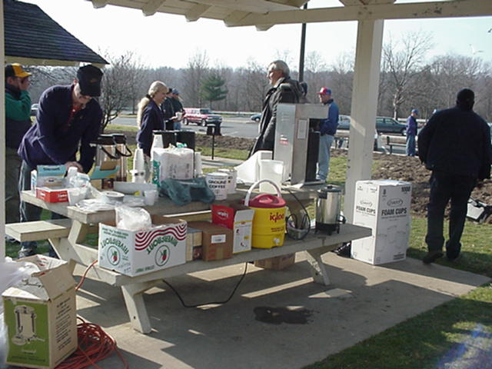

SAFETY(cont)
LIONS NEW
YEARS DAY
SAFETY DAYS

Slide 90


SAFETY(cont)
EMERGENCY EXITING
FINGER PRINTING

Slide 91
ENVIRONMENT
PROJECTS
  ADOPT A HIGHWAY
  CLEAN STREAM OR BEACHES
  RECYCLING OF ALUMINUM CANS ETC.
  PLANT TREES
  CLEAN HISTORIC SITES

Slide 92
SIGHT CONSERVATION
EDUCATE THE PUBLIC
  DIABETES
  BLINDNESS
  ACCIDENT PREVENTION
  EYE SCREENINGS

Slide 93
SIGHT & HEARING SCREENING VAN
LIONS FOUNDATION
ORGANIZED IN 1975
1 VAN
EYE PRESCREENING
HEARING PRESCREENING
GLAUCOMA TESTING
FREE TO PATIENTS

Slide 94


SIGHT & HEARING SCREENING VAN (CONT)

Slide 95


SIGHT & HEARING SCREENING VAN (CONT)
READY TO GO
SIGHT PRESCREENING

Slide 96


SIGHT & HEARING SCREENING VAN (CONT)
HEARING PRESCREENING
SIGHT PRESCREENING

Slide 97
SPECIAL NEEDS EQUIPMENT
PROVIDE EQUIPMENT TO PEOPLE
WHEEL CHAIRS
TYPE & SPEAK
BRAILLE & SPEAK
COMPUTER WITH JAWS WINDOW PROGRAMS
MAGNIFICATION EQUIPMENT CCTC
VOICE ACTIVATED READER
GLUCOSE METER BLIND
VOICE COMMUNICATION SYSTEM HEARING IMPAIRED

Slide 98


SPECIAL NEEDS EQUIPMENT (cont.)
BRAILLE
AWARD

Slide 99


SPECIAL NEEDS EQUIPMENT (cont.)
MAGNIFICATION EQUIPMENT
TYPE & SPEAK

Slide 100




PIN TRADING
STATE (PTCV)
INTERNATIONAL (LITPC)

Slide 101



PIN TRADING (cont.)
PIN SWAP

Slide 102
VIRGINIA LIONS EYE INSTITUTE
(VLEI)
ORGANIZATION THAT PROVIDES EYECARE
LOCATED NEAR INOVA HOSPITAL IN FALLS CHURCH
SCHOLARSHIPS FOR THE SIGHT IMPAIRED

Slide 103
YOUTH PROGRAMS

Slide 104
BLAND
MUSIC CONTEST
  CLUB, REGION, DISTRICT & STATE
VOCAL & INSTRUMENTAL
AGE YOUTH
PRIZES
SCHOLARSHIPS

Slide 105


BLAND (CONT)
VOCALIST
INSTRUMENTALIST

Slide 106

BLAND (CONT)
GENTLEMAN ON THE FAR RIGHT WAS A STATE WINNER

Slide 107
DRUG AWARENESS
EDUCATION OF YOUTH ON DRUGS
MENTORING PROGRAM

Slide 108
LEO CLUBS
PERSON BETWEEN THE AGES OF 12 AND 30
MOST LEOS IN USA ARE BETWEEN AGES OF12-19
CHARTERED IN MIDDLE OR HIGH SCHOOLS
MORE THAN 7,200+ LEO CLUBS
147,000+ MEMEBERS
IN 150+ COUNTRIES

Slide 109

LIONS CLUBS SPONSOR THE CONTEST IN THEIR COMMUNITY FOR CHILDREN IN LOCAL SCHOOLS OR ORGANIZED, SPONSORED YOUTH GROUPS
STUDENTS, AGES 11, 12 OR 13 ON NOVEMBER 15, 2003 ARE ELIGIBLE TO PARTICIPATE
STUDENTS SELCEDT A MEDIUM AS OUTLINED IN THE CONTEST RULES TO DRAW, PAINT OR SKETCH THEIR INTERPRETATION OF THE CONTEST’S THEME

Slide 110

PEACE POSTER (CONT)
2009-2010 GRAND PRIZE POSTER

Slide 111



PEACE POSTER
TAIWAN
GERMANY
NEW JERSEY
MERIT AWARDS 2009-2010

Slide 112
YOUTH EXCHANGE
BETWEEN THE AGES OF 15 AND 21;
BE SPONSORED BY A LIONS CLUB;
HAVE A BASIC KNOWLEDGE OF THE LANGUAGE OF THE HOST COUNTRY;
BE SUITABLE TO REPRESENT THEIR COMMUNITY, LIONS CLUB, AND COUNTRY;
BE WILLING TO ACCEPT THE CUSTOMS OF ANOTHER CULTURE.

Slide 113
YOUTH EXCHANGE (CONT)
YOUNG ADULTS VISIT FAMILIES FOR SIX WEEKS
COUNTRIES INVOLVED
  EUROPEANS
  CENTRAL AMERICA
  SOUTH AMERICA
  NORTH AMERICA
  ASIA

Slide 114
SCOUTING
LIONS CLUBS SPONSOR BOYS & GIRL SCOUTS TROOPS
LIONS ARE ONE OF THE LARGEST SPONSORS

Slide 115

YOUTH CAMP
NORTHERN VA LIONS YOUTH CAMP
LOCATED IN CLARKE COUNTY
~109 ACRES
WITH CABINS & DINING HALL
HIKING TRAILS
TENT SITES

Slide 116

YOUTH CAMP (CONT)
DEDICATION OF DURANT HALL
NATURE CLASS

Slide 117
YOUTH CAMP (CONT)
LIONS LIGHTHOUSE IN THE WOODS

Slide 118


YOUTH CAMP (CONT)
WOODBRIDGE LIONS REMODELED THIS CABIN
PAVILION

Slide 119
DUES
INTERNATIONAL=$21.50 EVERY 6 MONTHS OR $3.58/MONTH
FAMILY = $10.75 OR $1.79/MONTH
STATE = $16.00 OR $1.33/MONTH

Slide 120
DUES QTR (cont.)
3 MEALS = $ 75.00
INTERNATIONAL DUES = $10.75
STATE DUES = $4.00
CHRISTMAS SOCIAL = $6.50
CHARTER NIGHT = $6.50
INSTALLATION OF OFFCERS = $6.50
ADMINISTRATIVE = $.75
TOTAL = $110.00

Slide 121
QUESTIONS
QUESTIONS
ANSWERS

